Slide 1
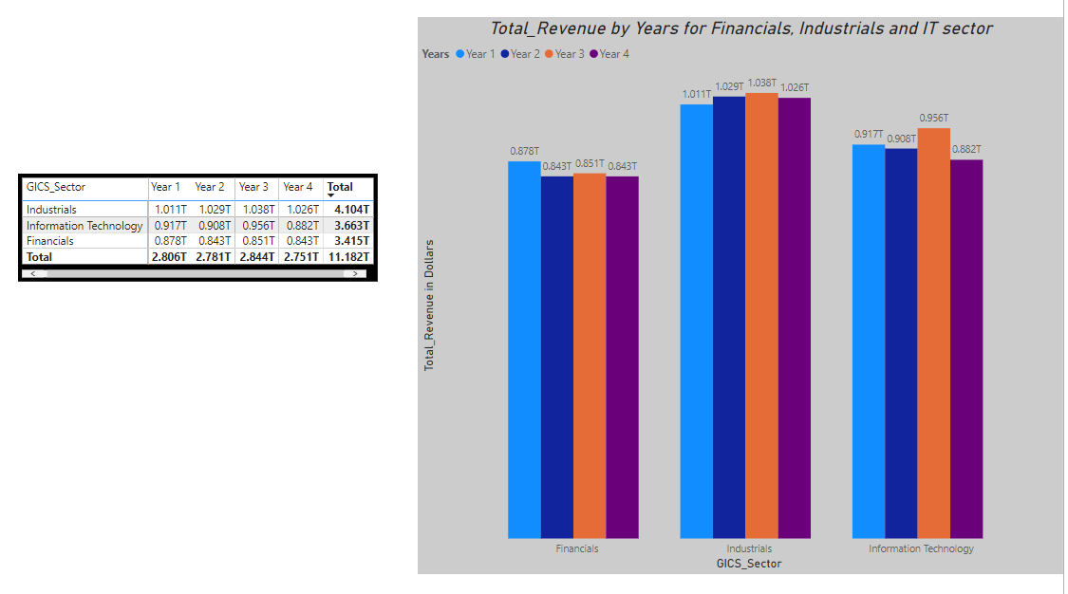
Does the IT, Financials and Industrials sector have the same increase in revenue for all the Years?
The graph shows the relationship between the revenues and years for the three sectors in question.
The three sectors do not follow a simultaneous increase in revenue over the years.
Here is a simple illustration of the Total revenue over the years
Financials: 1 - 4 - 2 - 3
Industrials: 3 - 2 - 4 - 1
IT: 3 - 1 - 2 - 4
The mean revenue for the Financials sector over the years is $853Bn which is the least compared to an average revenue of $1.03Tn and $915Bn for Industrial and IT sectors respectively. It is clear that companies in the Financials sector have the lowest revenue on average compared to the other two sectors, this could be tied to the fact that there are more companies in the IT and Industrial sectors (230 and 248) compared to the 164 companies in the Financials sector
The median total revenue for companies in the Industrial sector is highest among the three sectors with an estimated $1.027Tn while that of IT and Financials are $912Bn and $847Bn respectively. It looks like the 50% of companies in the Industrials sector have higher total revenue than 50% of companies in the IT and Financials sectors.
The mode Total Revenue for companies in the Financials sector is $3Bn, this means that most companies in the Financials sector make a total revenue of ~$3Bn, $4Bn for the Industrials sector and IT sector which means most companies in the Industrials and IT sector make a Total revenue of $4Bn.
The sectors have a very close range of revenue sector except for the IT sector which has a range of $73Bn caused by a sharp decline in Revenue for Year 4 at $881Bn unlike the Industrials and Financials with ~$35Bn and ~27Bn respectively. Because their range is more spread out, it appears that companies in the IT sector have greater variability in total revenues over time.
The standard deviation for revenue for companies in the Financials sector is $16,573,510,151 which is almost half of the companies in the IT sector ($30,469,652,974) whale that of the Industrials sector is $11,225,762,351. This implies that there is more variability for companies in the Industrials and Financials sector combined. This shows that companies in the IT sector have less constant revenues than both Financials and Industrials sectors combined. Although, more insights into the data shows that some selected sub-sectors like the Computer hardware are mainly responsible for this variation. So an advice to an investor will be to invest in more of the sub-industries rather than a sector itself.

Slide 2
Link to Sheets
Task 1: https://docs.google.com/spreadsheets/d/1iKsR0UoCDKuCsvcgfc--HagmeSZoDCZsQ1kNLL-Va_4/edit?usp=sharing
Task 2: https://docs.google.com/spreadsheets/d/1gQZQ7VOuAeYA6GYjJVWKZfCiKUc7-ukcMUeQv3Ph1U0/edit?usp=sharing
Task 3: https://docs.google.com/spreadsheets/d/1kUKmgkBzKH6tZnz5w8zOfsA__5wlglxUuq0VIb2xmk8/edit?usp=sharing

